Slide 1
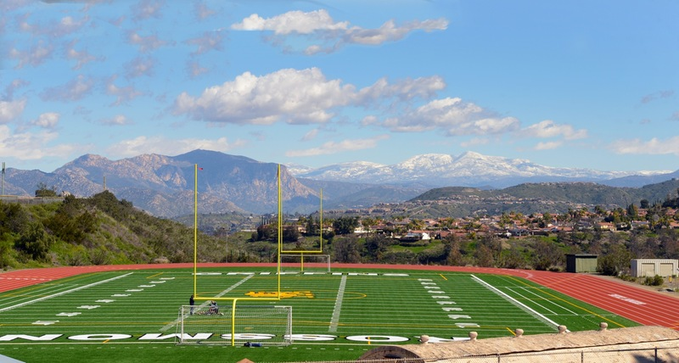


VIRTUAL ATHLETICS FORUM ATHLETIC COMPETITION SPRING 2021
z

Slide 2

WELCOME
Presented by Dr. Marsha Gable
Interim President Grossmont College
z

Slide 3
ATHLETICS UPDATES
Presented by Nedra Brown
Associate Dean of Athletics & Athletic Director
z

Slide 4
Athletics Updates
Presented by Nedra Brown– nedra.brown@gcccd.edu
z
Grossmont College opted out of competition for the upcoming California Community College Association (CCCAA) Spring I season
  Sports affected include football, women's soccer, men's and women's basketball, men's and women's water polo, and women's volleyball
Spring II sports competition windows begin on March 27, 2021, with April 10 marking the first day of official competition
  The Spring II sports at Grossmont include baseball, softball, men's and women's tennis, badminton, men's and women's swimming, beach volleyball and men's volleyball
  The deadline to opt-in or opt-out of the Spring II portion of the athletic season is Feb. 26

Slide 5
What is contact tracing?:
  The tool we use to stop the spread of Covid-19
  It’s the who, what, where, and when
Who do I contact if I am exposed or diagnosed with Covid-19?:
  Student Health & Wellness Covid reporting form
  Joe Parry (Athletics Trainer)
What’s the difference between quarantine & isolation?:
  Quarantine: you stay in your house and only leave to see the doctor or to get tested
  Isolation: you separate yourself from others in your household - usually your own room and bathroom.
Contact Tracing
Presented by Elaine Adlam
Health and Wellness elaine.adlam@gcccd.edu

Slide 6
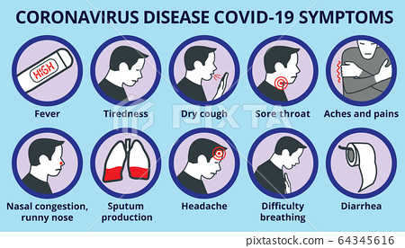
If you are in quarantine, we will ask you to look for these symptoms and ask you to call 619-644-7192 for further instructions. If severe, call 911.
Symptom Check
Presented by Elaine Adlam elaine.adlam@gcccd.edu

Slide 7

Stay Safe
Presented by Elaine Adlam elaine.adlam@gcccd.edu
Contact:
Student Health & Wellness:
619-644-7192
or
www.grossmont.health@gcccd.edu

Slide 8

Athletic Training
Presented by Joseph Parry and Chris Ray
joseph.parry@gcccd.edu or chris.ray@gcccd.edu
z
Should I still fill out my medical paperwork?
  Yes
Should I still get my physical done?
  You may wait for now, but know that you will need one completed, and all forms filled out before you participate in any practice on campus
Will getting a physical now count for next fall or spring?
  YES, you will only need to complete a medical questionnaire for the 2021/22 season if you complete your physical fall 2020 or spring 2021
Where can I find the medical forms?
https://www.grossmontgriffins.com/information/Athletic_Training/Athletic_Training_Forms

Slide 9

WHAT IS THE DEAL WITH COVID TESTING?
Athletic Training
Presented by Joseph Parry and Chris Ray
joseph.parry@gcccd.edu or chris.ray@gcccd.edu
Factors:
What will be the current CPHD guidelines for college sports?
Is your sport going to be indoor or outdoor?
Is your sport considered high, intermediate or low risk?
Is your sport competing OR just training with mitigation

Slide 10


Slide 11
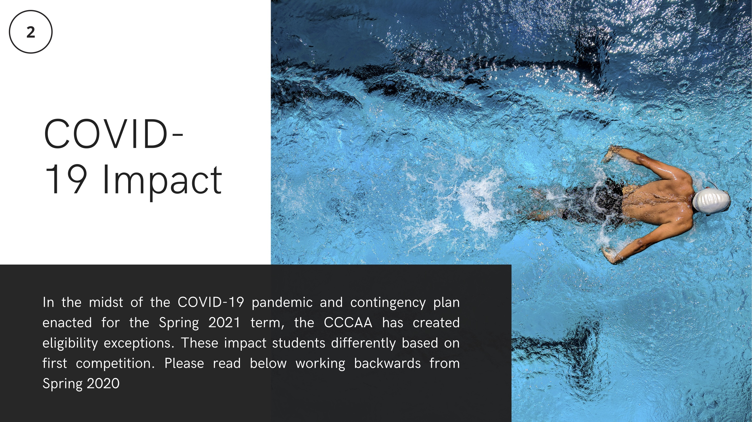

Slide 12
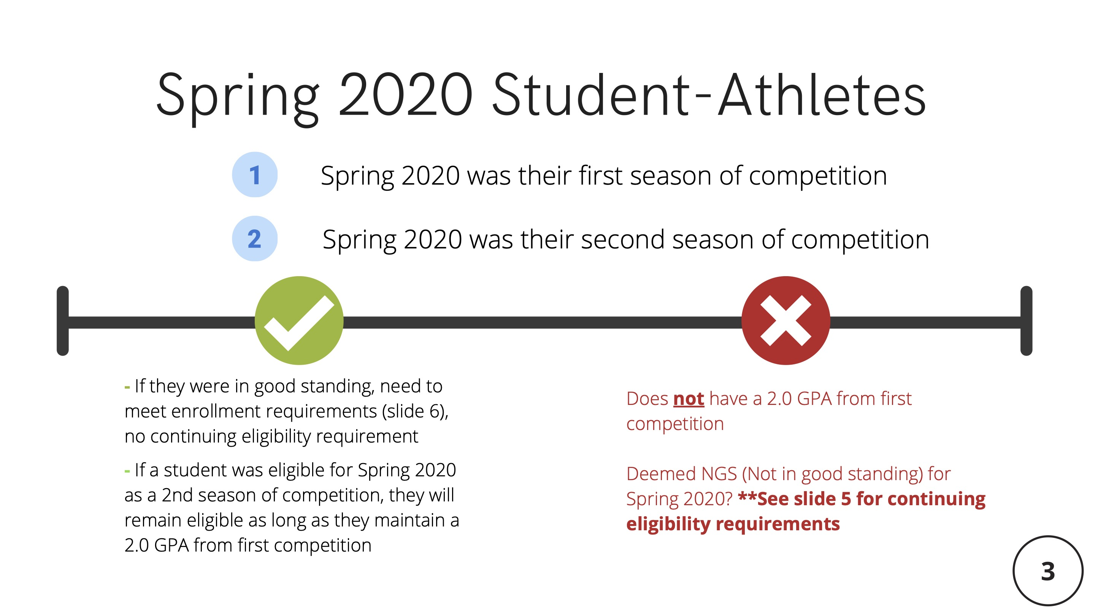

Slide 13
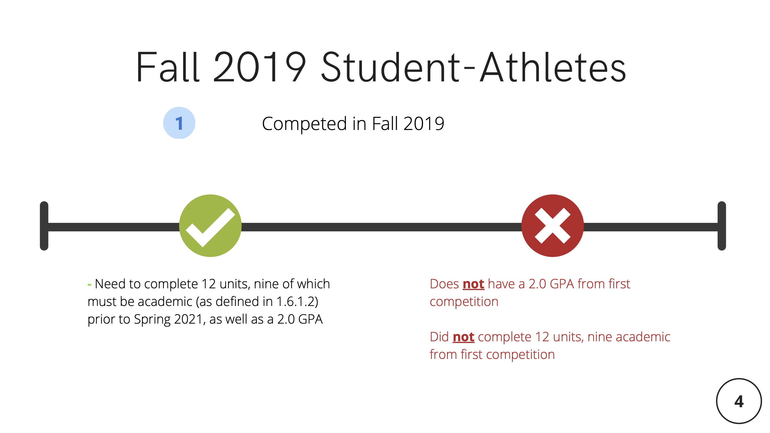

Slide 14
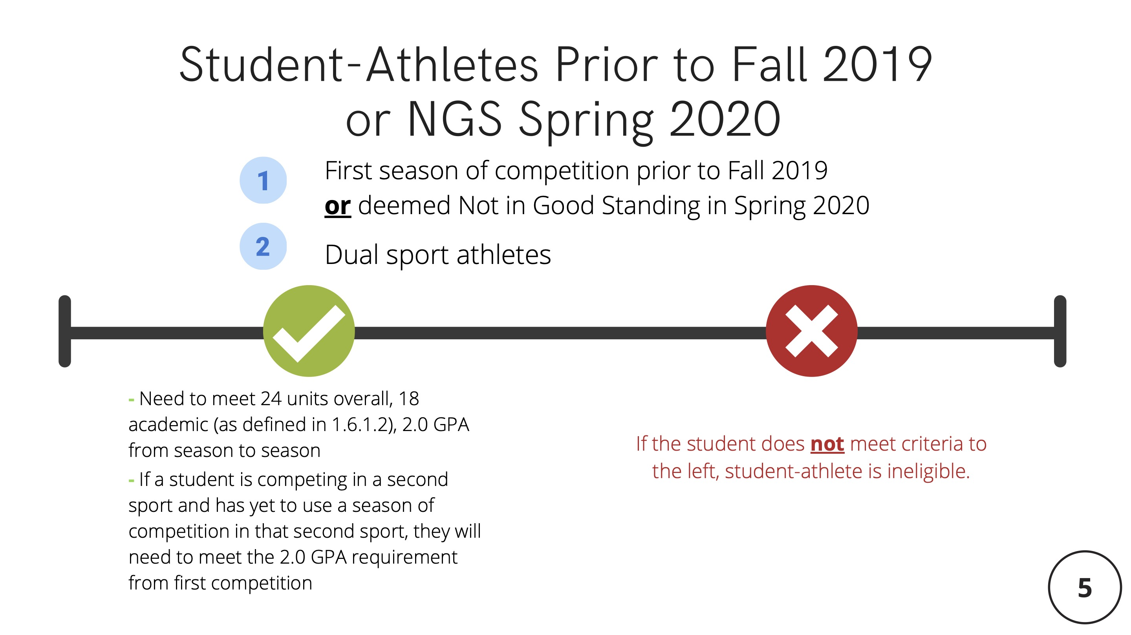

Slide 15
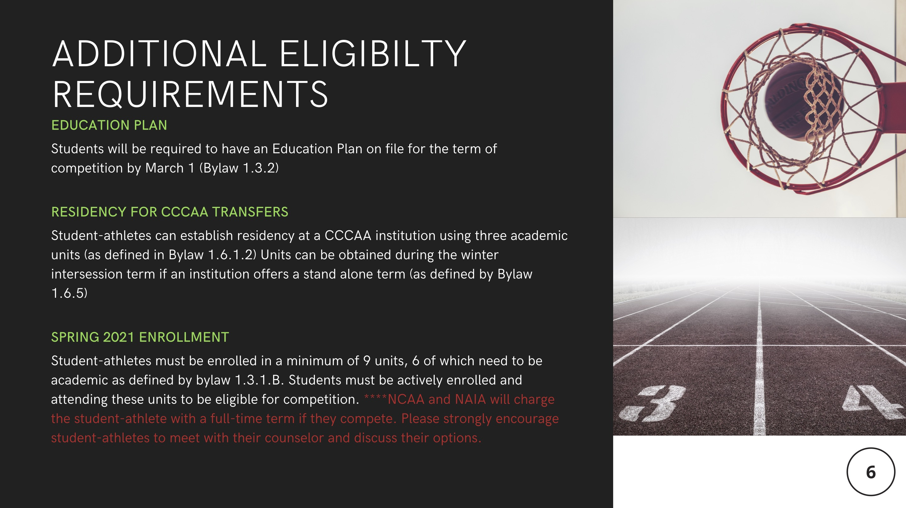

Slide 16
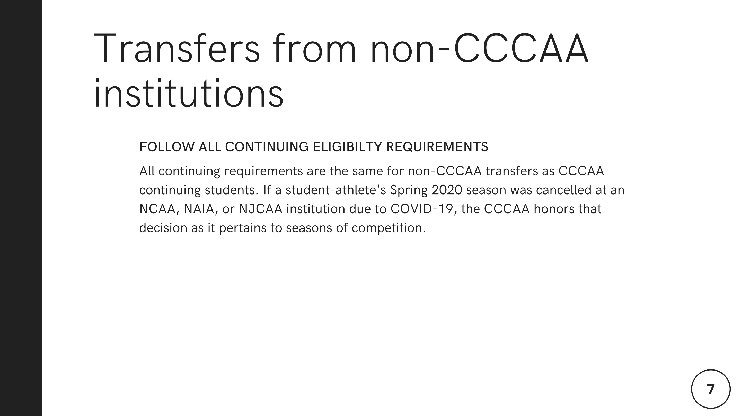

Slide 17
Eligibility Questions?
Heidi Holmquist – heidi.holmquist@gcccd.edu
Athletic Eligibility Advisor

Slide 18

Preparing for Success
After Grossmont College
Presented by Patrick Aure – patrick.aure@gcccd.edu
z
Athletic Transfer Advising:
Transfer Options:
  NCAA Division I
  NCAA Division II
  NCAA Division III
  NAIA
Waivers Opportunities:
  NCAA DII, DIII, and the NAIA will recognize the CCCAA’s restoration of a season
  NCAA DI will not automatically recognize the CCCAA restoration of a season, but each institution can self-apply the season of competition and extension upon transfer instead of having to go through the typical waiver process.

Slide 19
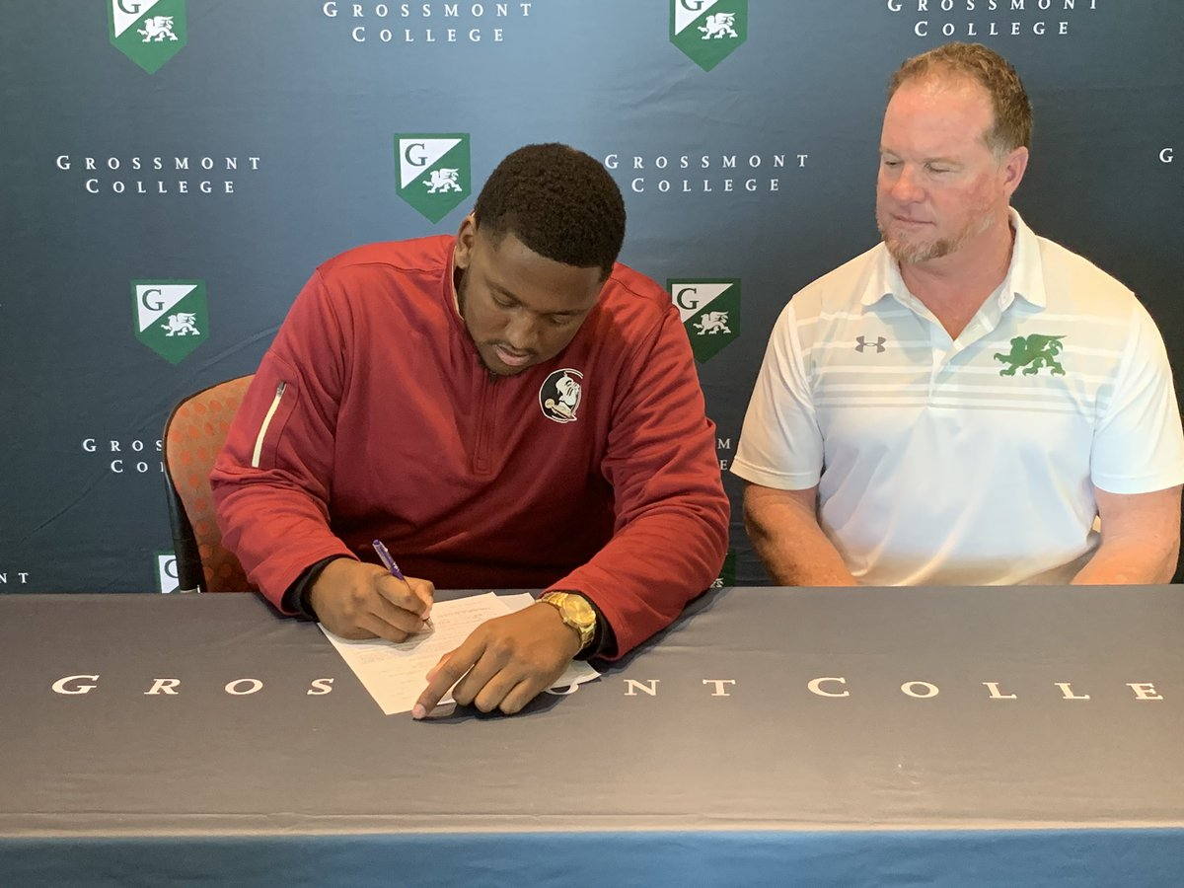
Preparing for Success
After Grossmont College
Presented by Patrick Aure – patrick.aure@gcccd.edu
While You’re at Grossmont College:
  Grey Shirts
  Red Shirts
  NCAA Division I: 40 / 60 / 80 Transfer Rule
    Staying a Third Year
      Going Part-Time One Semester
        Financial Aid Considerations

Slide 20
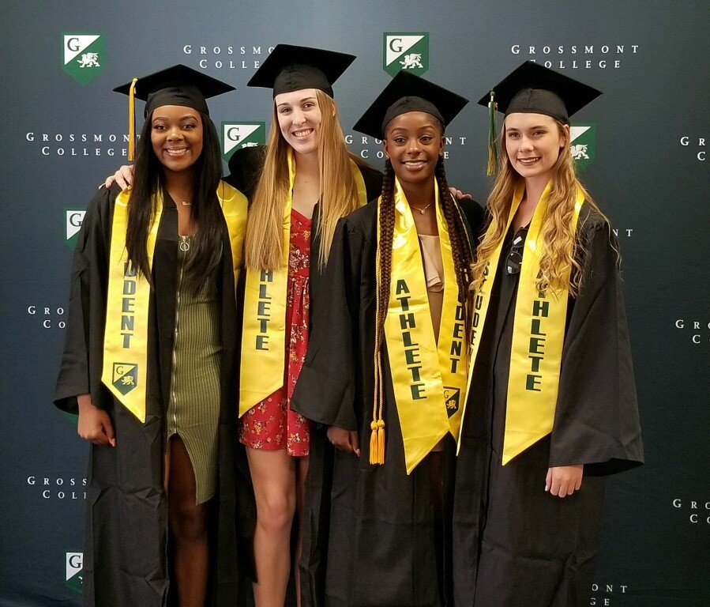
Preparing for Success
After Grossmont College
Presented by Patrick Aure – patrick.aure@gcccd.edu
We’re Here to Support YOU!
Patrick Aure – Athletic Academic Advisor
  patrick.aure@gcccd.edu
Juan Contreras – Athletics Counselor
  Tuesdays/Thursdays, 9AM – 3PM
  Visit www.grossmontgriffins.com
    Academic Counseling
      eCounseling
      Virtual Appointment

Slide 21

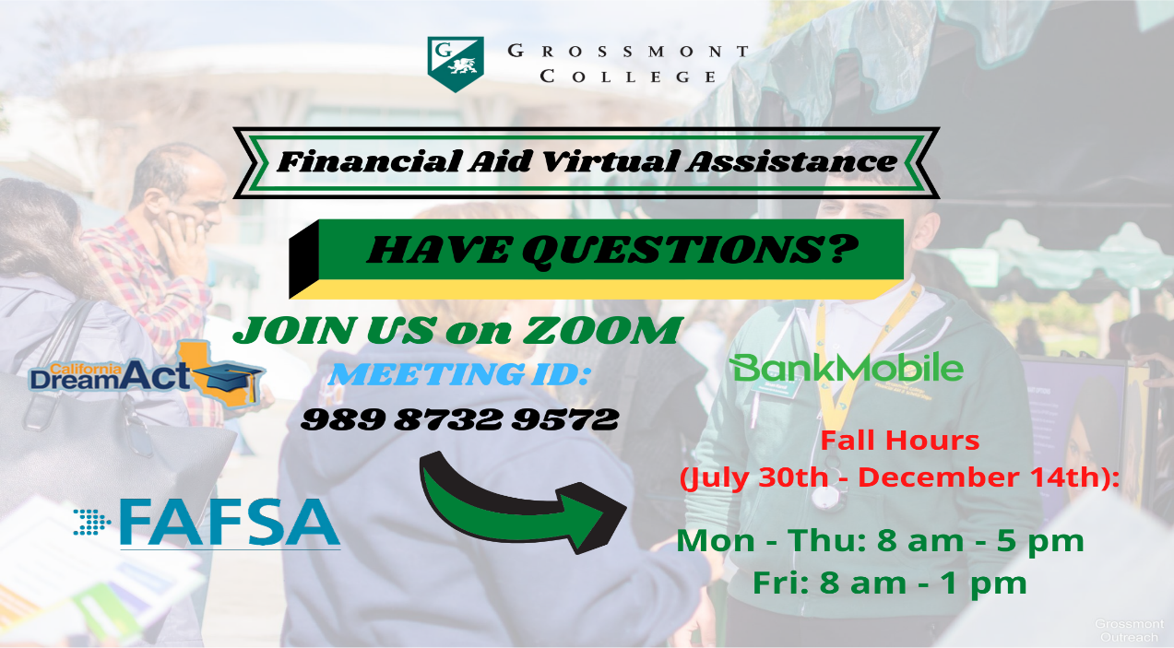
Financial Aid & Scholarships
Presented by Diana Barajas – diana.barajas@gcccd.edu
What do you need to know?
Currently, all Financial Aid policies regarding enrollment, attendance and Satisfactory Academic Progress (SAP) remain in effect and unchanged. EWs will not be counted in SAP.
How to Contact Us:
We currently are unable to return phone calls.
For specific questions, contact your Advisor:
A-B, Via Rapida - nadia.almaguer@gcccd.edu
C- G, Umoja - luma.shamon@gcccd.edu
H-L, Veterans - brenda.gates@gcccd.edu
M-R - andre.bin-walee@gcccd.edu
S-Z, Puente, CADA - iliana.garcia@gcccd.edu
Guardian Scholars - diana.barajas@gcccd.edu
To submit documentation:
Email COMPLETED documentation to grossmont.fa.outreach@gcccd.edu.
Please include Name and Student ID in email.

Slide 22
Financial Aid & Scholarships
Presented by Diana Barajas – diana.barajas@gcccd.edu

Slide 23
Financial Aid & Scholarships
Presented by Diana Barajas – diana.barajas@gcccd.edu
Grossmont College Promise – Free
The Grossmont-Cuyamaca College Promise provides two free years of tuition and payment of mandatory fees at Grossmont or Cuyamaca College for first-time students who are attending college full-time.
California College Promise Grant Fee Waiver – Fees
Formerly known as The Board of Governors (BOG) Fee Waiver program, the California College Promise Grant provides three ways to help you pay fees and it also makes you eligible for a reduced parking permit fee.

Slide 24
Scholarships
Presented by Josceline Torres – josceline.torres@gcccd.edu
Scholarship Specialist
What is a scholarship?
It’s a payment made to support a student's education, awarded on the basis of academic or other achievement.
It can be used to pay tuition, books, supplies, transportation expenses, & other educational expenses.

Slide 25
Scholarships
Presented by Josceline Torres – josceline.torres@gcccd.edu
Campus-Based Scholarships:
  Institutional Scholarships
  OSHER
  Our Fall 2021 application period will open the week of February 15th, 2021.
  To apply go to www.gcccd.academicworks.com
Outside Agency Scholarships:
  Non-Institutional Scholarships
    Non-profit organization (San Diego Foundation; during their application period, place of worship), Big companies (Coca-Cola, Nike, Taco Bell, etc.), and your current employer (if they offer scholarship opportunities).
    If transferring, contact school for application information.
Scholarships range in criteria and deadlines are set by the sponsor

Slide 26

z
Student-Athlete COVID-19 Help
For student-athlete questions and assistance, please fill out our
STUDENT-ATHLETE COVID-19 HELP
Find it at www.grossomontgriffins.com

Slide 27
Governing Board Members: Elena Adams, Linda Cartwright, Debbie Justeson, Brad Monroe, Julie Schorr
Student Members: Benjamin Blevins, Robert McClain
Chancellor: Lynn Ceresino Neault, Ed.D.
Grossmont College President: Nabil Abu-Ghazaleh, Ed.D. (Note: After Jan. 1,2021, Grossmont College Interim President: Marsha Gable, Ed.D.)
Cuyamaca College President: Julianna Barnes, Ed.D.
z

