Slide 1
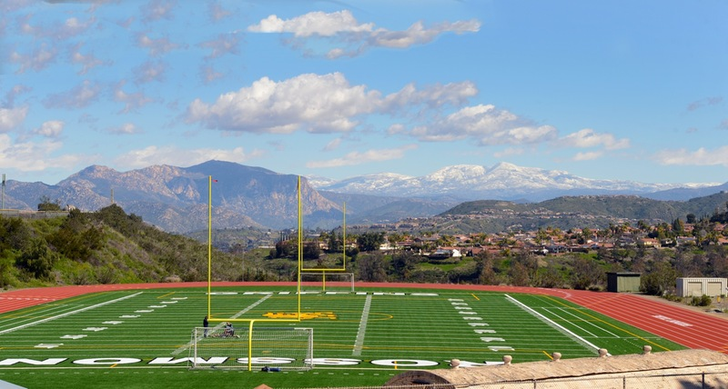


VIRTUAL ATHLETICS FORUM
z

Slide 2


Welcome
Pacific Coast Athletic Conference
Athletics Update
Academic Advising
Virtual Commencement
Counseling
Admissions & Records
Eligibility
Athletic Training
Equipment
Financial Aid
Q & A
z

Slide 3
WELCOME
Presented by Aaron Starck
Interim Vice President of Student Services
z

Slide 4
PACIFIC COAST ATHLETIC CONFERENCE (PCAC)
Commissioner John Woods
z

Slide 5
ATHLETICS UPDATES
Presented by Nedra Brown
Associate Dean of Athletics & Athletic Director
z

Slide 6
Athletic Updates
Presented by Nedra Brown– nedra.brown@gcccd.edu
z
Purpose:
  Check in and get a pulse on our student-athletes
  Allow AD/Staff the opportunity to address students and coaches in a live forum
  Provide the opportunity for students to get transparent and clear information about the status of academics and athletics now and moving forward
  Allow for students to communicate directly how COVID-19 has and is affecting their academic and athletic experiences
  Access to other student services representatives on campus
  Full Question and Answer session available for students
Athletic Goals:
  Retention of Student-Athletes
  Academic Success of Student-Athletes
  Continued Fitness and Skill Development of Student-Athletes
  Maintain a Positive and Active Athletics Social Media Presence
  Develop a Plan of Action for Return to Practice & Competition

Slide 7
Athletic Updates
Presented by Nedra Brown– nedra.brown@gcccd.edu
z
Summer Updates:
  All Intercollegiate classes will take place remotely
    Football, Women’s Soccer, Women’s Volleyball, Men and Women’s Water Polo
  Training and preparation will take place via this learning module to prepare you for your Fall seasons (tentative)
Opportunities for Fall Practice Start Dates – 3 Options:
  August Practice Dates; September Start Date
  September Practice Date; October Start Date
  October Practice Date; November Start Date
Phases for Competition:
  Staggered/Later start dates for Fall sports
  Looking at reasonable training time to be prepared for seasons (will need minimum 6 weeks)
  All Work Groups are meeting to decide the best possible options to participate in some way for Fall Sports
  Pushing all Spring Sports back

Slide 8
Athletic Updates
Presented by Nedra Brown– nedra.brown@gcccd.edu
z
Reminder:
  It’s also important to note that the statewide stay at home order is still in effect. This means that the recruiting ban, which precludes face-to-face contact and travel related to recruiting, is also still in effect. CCCAA will make an announcement when the ban has been lifted.

Slide 9
Athletic Academic Advising
Presented by Patrick Aure – patrick.aure@gcccd.edu
z
Deadlines:
  Summer Registration: May 11 – June 21
  Student-Athlete Priority Registration began Tuesday, May 12
  Summer School Dates: June 22 – July 30
  Last Day to Withdraw without a “W” and Get a Refund: Friday, June 25
  Summer Graduation Application Deadline: July 2
Athletics Website:
    www.grossmontgriffins.com – COVID-19 Campus Updates and Remote Resources
    Continued athletic and academic support
    Support staff contact information available

Slide 10
Athletic Academic Advising
Presented by Patrick Aure – patrick.aure@gcccd.edu
NCAA Update:
  COVID-19 Relief
    DI Schools will have authority to apply a 1-year extension for Spring 2020 sport student-athletes
    Recruiting dead period has been extended to May 31
  Part-Time Consideration
    Implications
Remote Counseling:
    Educational Planning and other Counseling Services Available
    Contact Juan Contreras – juan.contreras@gcccd.edu
  Contact Information:
      Email – patrick.aure@gcccd.edu

Slide 11
VIRTUAL COMMENCEMENT
Presented by Sara Varghese
Dean of Student Affairs
z

Slide 12

z

Slide 13
z
Counseling Center
Counselors are available online to support you during this crisis. Do not hesitate to contact us if you have any questions.
We can help you with:
Academic/Transfer Counseling
Career Counseling
Personal/Crisis Counseling
International Counseling
If you would like to make an appointment with the Transfer Center please email them directly at grossmont.transfer@gcccd.edu.
Counseling
Presented by Juan Contreras juan.contreras@gcccd.edu

Slide 14
Counseling Website:
https://www.grossmont.edu/student-services/offices-and-services/counseling/default.aspx
eCOUNSELING
  Quick questions, no transcripts will be available
  Add/Drop class processes
  Graduation questions
ASK A COUNSELOR
  Quick questions, Transcripts will be available
  Abbreviated Ed Plan (1 semester)
  Academic Renewal Petitions
  Consortium Agreements
  ESL Ed Plan
  Pass/No Pass
  Assessment Placement Results
1-HOUR VIRTUAL APPOINTMENTS
  1-hour Appointment
  Max Unit Financial Aid Petition
  Comprehensive Ed Plan
  Transfer/Graduation Planning
z
Counseling
Presented by Juan Contreras juan.contreras@gcccd.edu

Slide 15
Admissions & Records Website:
https://www.grossmont.edu/student-services/applyenroll/default.aspx
Dropping Classes:
If you need to drop your classes due to COVID-19 reasons, please follow these steps:
Self-Service Drop Steps Instruction
  Students have until the last day of the term to drop
  All withdrawals related to COVID-19 will result in an EW and a refund issued
  Unlike a “W,” an “EW” will not be used for determining progress or in the GPA calculation by the campus
  This may not be true for Financial Aid, so please see your financial aid advisor
z
Counseling
Presented by Juan Contreras juan.contreras@gcccd.edu

Slide 16
z
Counseling
Presented by Juan Contreras juan.contreras@gcccd.edu
211 San Diego:
https://211sandiego.org
  Coronavirus (COVID-19) Information & Resources
  Food Resources During COVID-19
  Health Resources During COVID-19
  Housing Resources During COVID-19
  Financial Income & Employment Resources During COVID-19
  LIHEAP & Utility Resources During COVID-19
  Other Resources During COVID-19

Slide 17
Admissions & Records
Presented by Lisa Lundgren – lisa.lundgren@gcccd.edu
z
Important Dates:
  Pass / No Pass Deadline: June 1st
  Summer Registration: May 11th
  Summer Session: June 22nd – July 30th
  Summer 2020 Graduation Application Deadline July 2nd
  Outgoing Transcripts – SDSU is being sent twice a week, all others twice a month.
  Email: grossmont.admissions@gcccd.edu
Evaluations:
  Graduation – Awarding degrees & certificates
  Evaluate incoming transcripts
  Certificate of General Education sent to CSU & UC Campuses
  Email: grossmont.evaluations@gcccd.edu
Dual Enrollment:
  Students can enroll 11.5 units
  We will accept emails from your HS counselor as signatures
  Email: linda.elia@gcccd.edu
International Students:
  As a F1 visa student, you must remain in 12 degree-applicable / transferable units
  Application for Fall 2020 is open until July 15th, tell your friends and family abroad if they are interested in studying at Grossmont College and living in San Diego
  Visit www.grossmont.edu/international and look for COVID-19 Updates. Rules and guidance have been changing every few days, and most updated information will be found on that website.

Slide 18
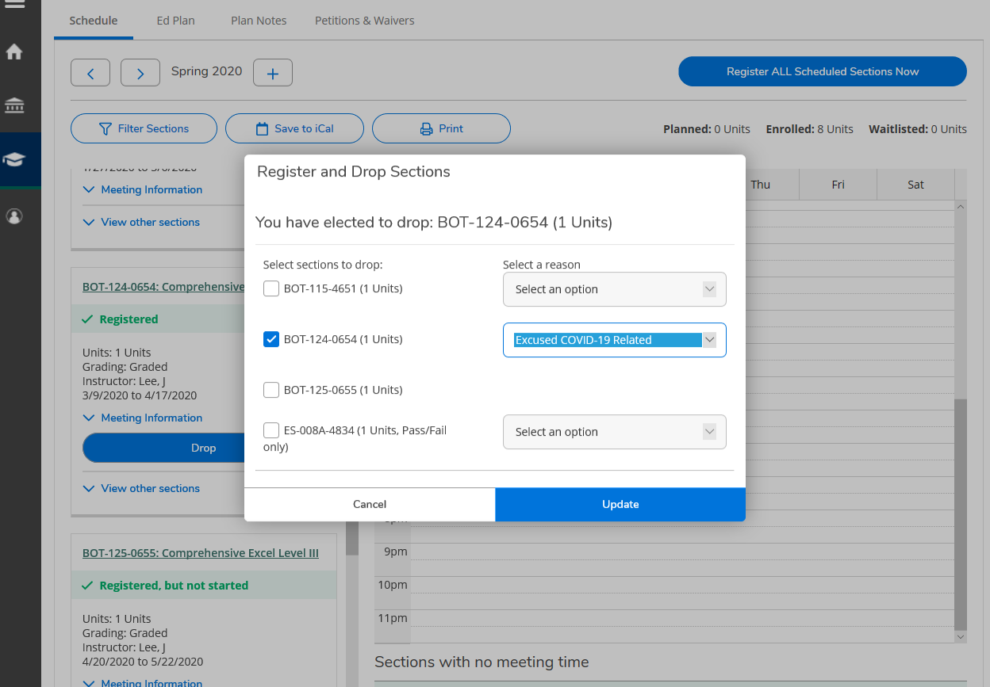
z
Do you want to drop courses?
We are here for you:
Log in to WebAdvisor.
Go to "Student Menu" and select "**Search, Plan, and Register**."
Once you are in Self-Service, go to your course schedule.
Select drop and a pop-up will appear.
On left hand side, check mark the courses that have been affected by COVID-19 and on the right-hand side select the reason.
Make sure to select a reason for every course you are dropping.
GCCCD COVID-19 Late Withdrawal Form

Slide 19
Eligibility – Student-Athletes
Presented by Heidi Holmquist – heidi.holmquist@gcccd.edu
Athletic CCCAA Eligibility Updates
Returning Student-Athletes (due to COVID-19):
SPRING 2020 intercollegiate competitors in good standing have their season re-instated.
FALL 2020 returning student-athletes that last competed Fall 2019 will need 12 overall/9 academic to participate and maintain 2.0 GPA instead of the 24 overall/18 academic.
SPRING 2020 1st and 2nd year competitors must maintain 2.0 GPA from first competition to compete Spring 2021.
SPRING 2020 student-athletes who were on FORM 3 and in good standing may compete Spring 2021 with 9 overall units/6 academic but consistent with CEP.
Due to COVID-19 and due to access and learning issues the six units in the last full-time requirement will not be applied for 20-21 eligibility certifications.
Meeting transfer residence from one CA community college instead of 12 units in residency may compete by completing 3 units prior to competition.

Slide 20
Eligibility – Student-Athletes
Presented by Heidi Holmquist – heidi.holmquist@gcccd.edu
Athletic CCCAA Eligibility Updates
New Student-Athletes – 1st Year Eligibility:
Actively enrolled in 12 overall/9 academic must be actively enrolled during season of competition.
Be enrolled in intercollegiate sports class.
Complete all paperwork for Athletic Training Room including physical
Meet with Academic Counselor to complete CEP.

Slide 21
Athletic Training
Presented by Joseph Parry and Chris Ray
joseph.parry@gcccd.edu or chris.ray@gcccd.edu
z
Attention Student-Athletes:
In order to be cleared to participate in any practices or contests, ALL athletes must have the following forms completed and returned directly to the Athletic Training Staff:
Student-Athlete Checklist
Physical Screening Examination
    Must include Dr. stamp and signature
    Physical must be done by an M.D. or D.O
COVID-19 Screening Form
    Must include Dr. stamp and signature
Insurance Verification Form
Liability Waiver Form
Concussion Information & Acknowledgment
Baseline Concussion Assessment
All forms available on www.grossmontgriffins.com

Slide 22



Slide 23
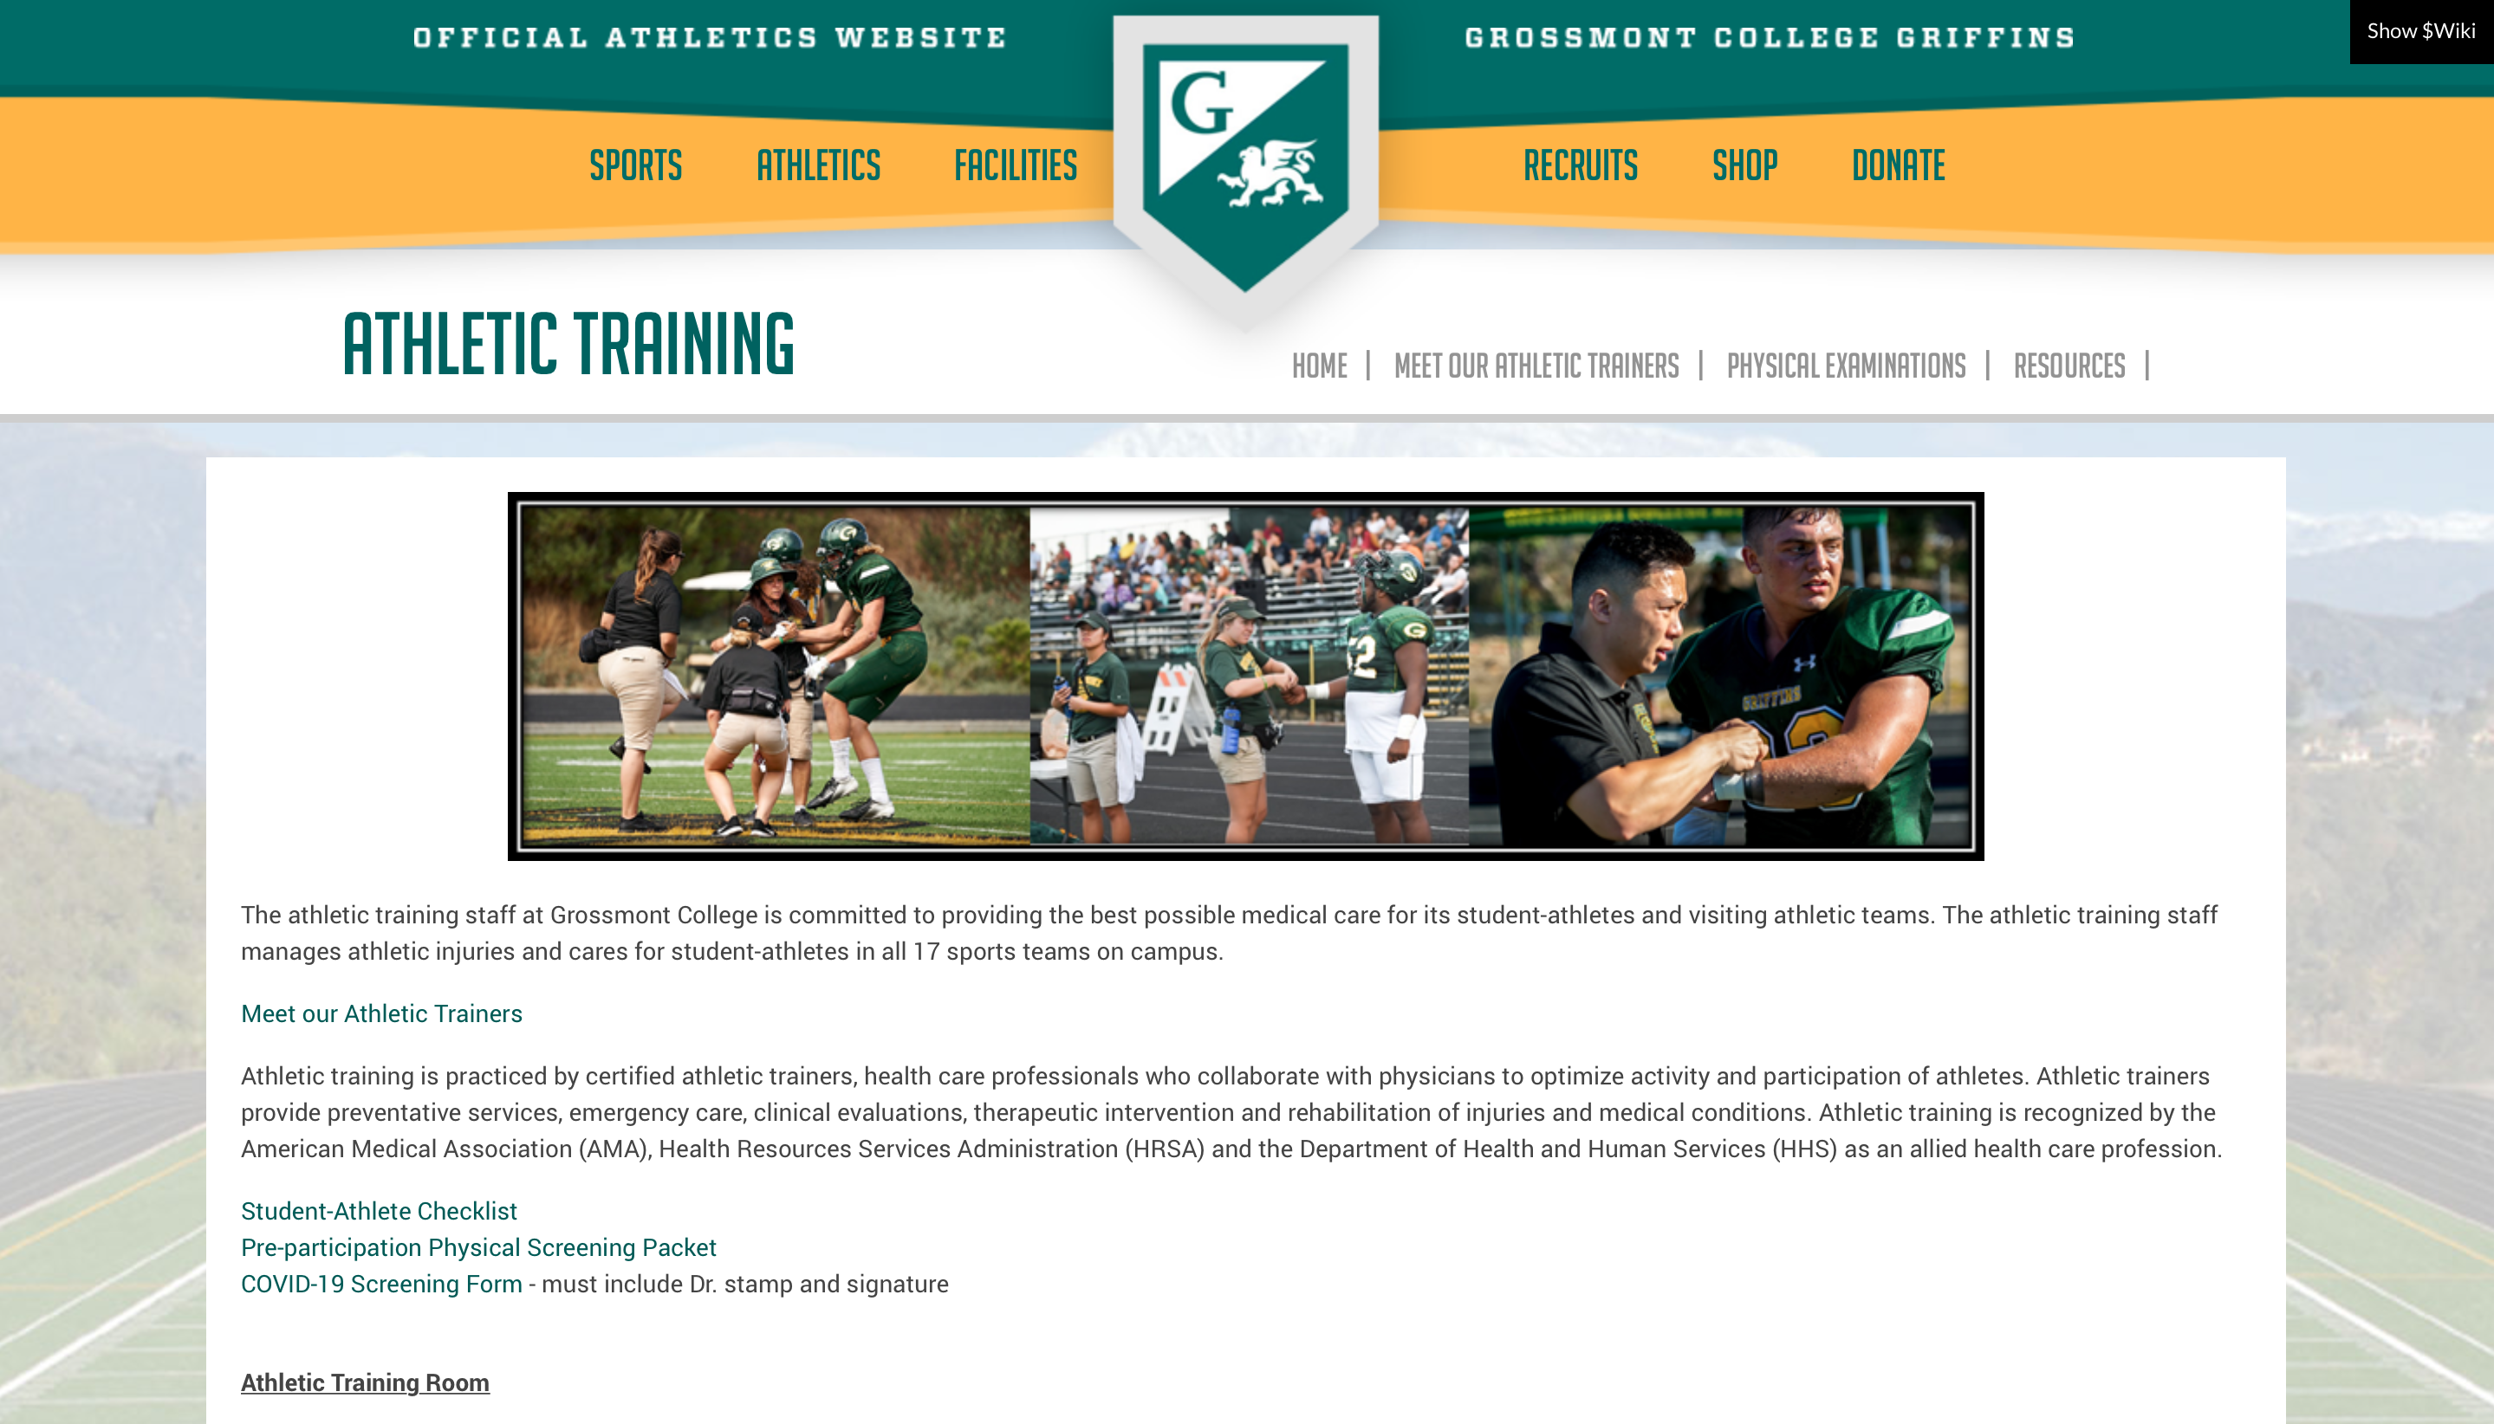

Slide 24
Athletic Training
Presented by Joseph Parry and Chris Ray
joseph.parry@gcccd.edu or chris.ray@gcccd.edu
GROSSMONT ATHETIC TRAINING
PROCEDURE CHANGES DUE TO COVID-19 PANDEMIC:
  INCREASED CLEANING PROCEDURES
  USE OF Personal Protective Equipment (PPE) BY ATHLETIC TRAINING STAFF AS DIRECTED
  NO COMMUNAL WATER BOTTLES – ATHLETES BRING THEIR OWN, CUPS PROVIDED
  LIMIT NUMBER OF PERSONS IN THE CLINIC AT ONE TIME
  IF YOU ARE SICK YOU ARE EXPECTED TO STAY HOME!!!
  SOME TAPE AND BANDAGES LOCATED AT THE ENTRANCE OF THE CLINIC FOR QUICK ACCESS AND TO HELP LIMIT NUMBERS
  DAILY SCREENING REQUIRED FOR ALL STUDENT-ATHLETES
    QUESTIONNAIRE
    TEMPERATURE CHECK

Slide 25
Equipment Management
Presented by Tim Halbig timothy.halbig@gcccd,edu
How to Return Athletic Equipment
  Gear must be returned as soon as campus is open
Clearing Athletic Holds
  Student-athletes with a hold can get temporary release to register for classes by contacting caroline.althaus@gcccd.edu
For More HELP Contact Tim Halbig:
  Email – timothy.halbig@gcccd.edu

Slide 26

Financial Aid & Scholarships
Presented by Diana Barajas – diana.barajas@gcccd.edu
What do you need to know?
Currently, all Financial Aid policies regarding enrollment, attendance and Satisfactory Academic Progress (SAP) remain in effect and unchanged. There may be changes that result because of the CARES Act that are unknown at this time.
Emergency Grants:
Due to the number of applications received, additional funding is being sought after to award as many students as possible.
How to Contact Us:
We currently are unable to return phone calls.
For specific questions, contact your Advisor:
A-Bm, Via Rapida - nadia.almaguer@gcccd.edu
Bn- E, Umoja - luma.shamon@gcccd.edu
F- K, Veterans - brenda.gates@gcccd.edu
L-R - andre.bin-walee@gcccd.edu
S-Z, Puente, CADA - iliana.garcia@gcccd.edu
Guardian Scholars - diana.barajas@gcccd.edu
To submit documentation:
Email COMPLETED documentation to grossmont.fa.outreach@gcccd.edu

Slide 27

z
Student-Athlete COVID-19 Help
For student-athlete questions and assistance, please fill out our
STUDENT-ATHLETE COVID-19 HELP

Slide 28
Q & A
Please submit your questions to “Everyone” within the chat or
Submit your questions privately to the “Host”
z

